Slide 1
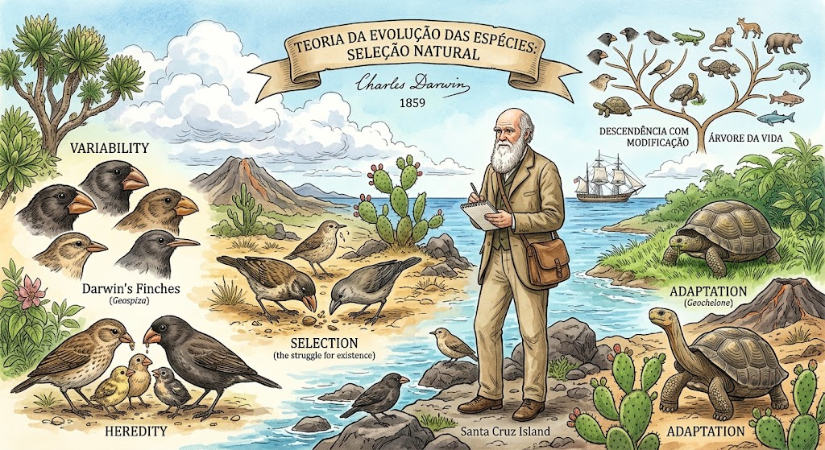
1859

Slide 2
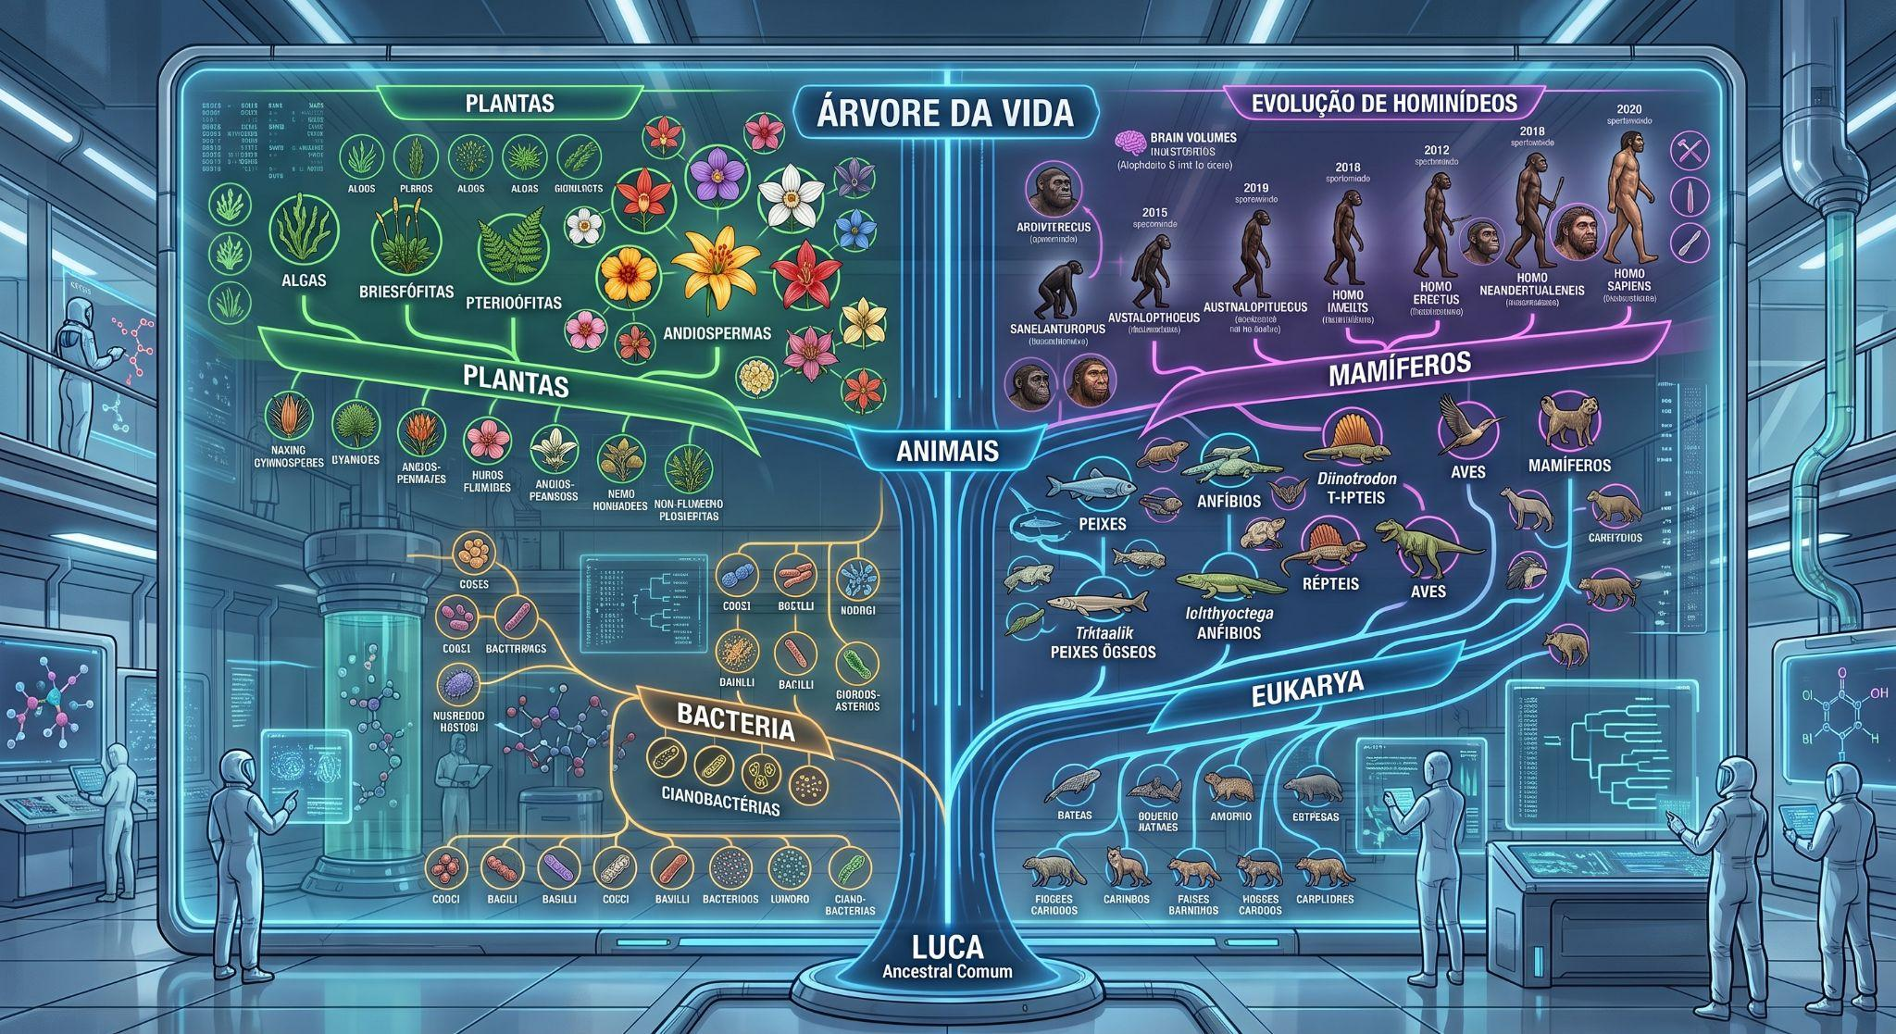

Slide 3
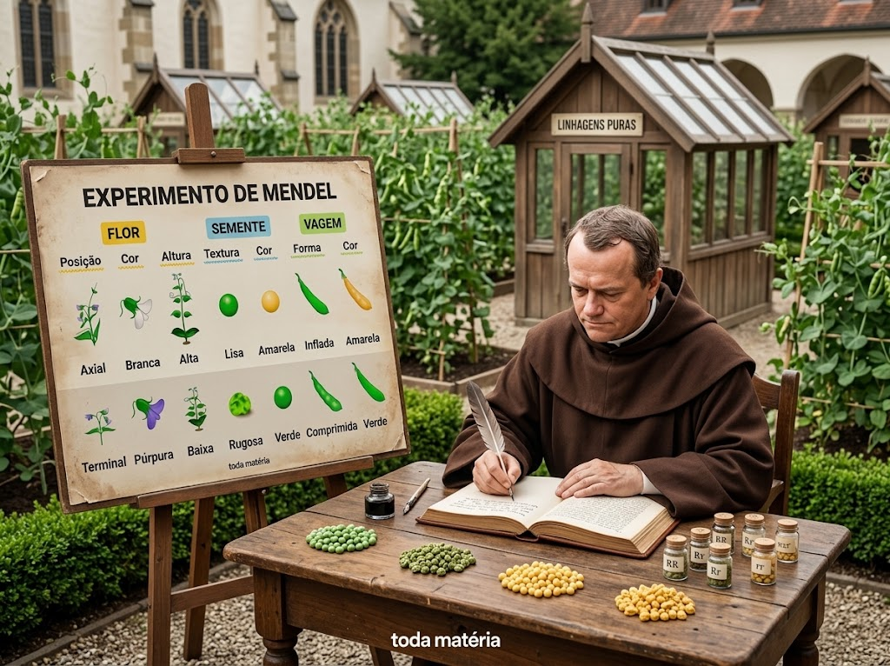
1866
Gregor Mendel “Fenótipo”

Slide 4
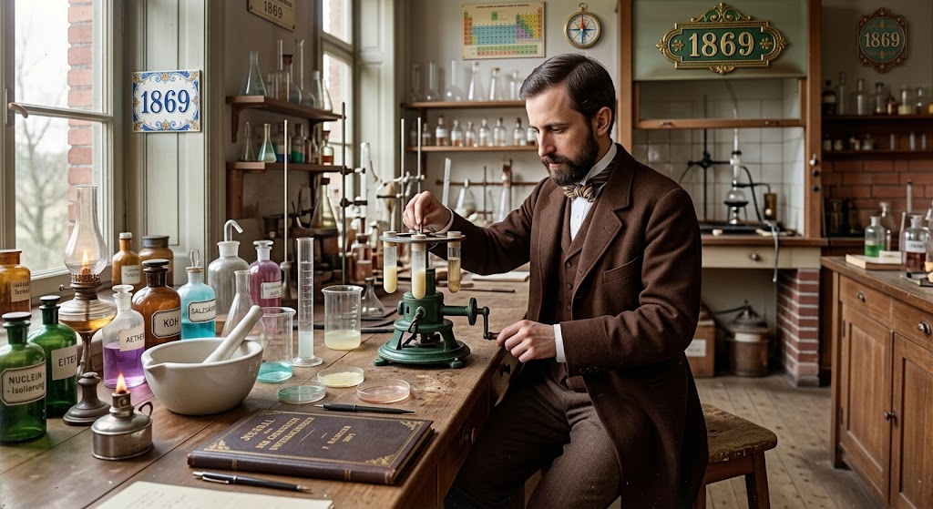
Friedrich Miescher DNA

Slide 5
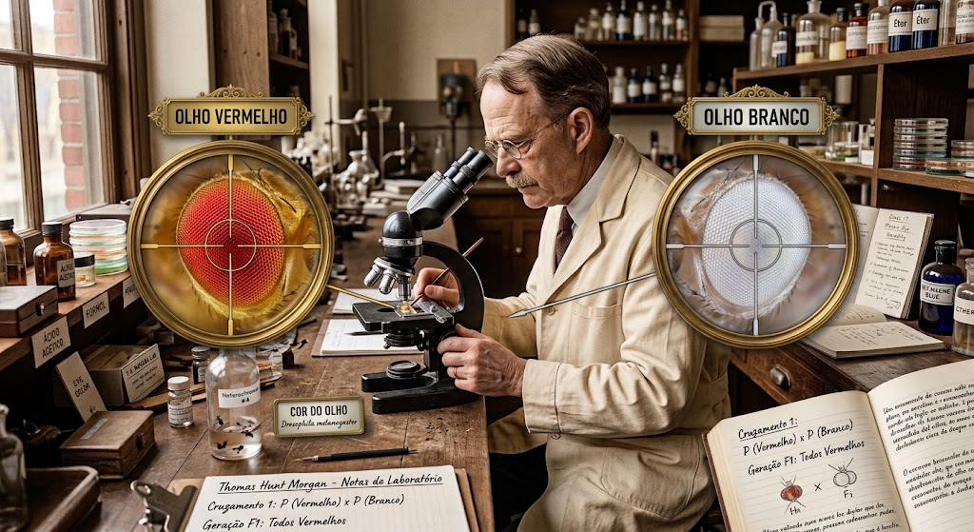
1877

Slide 6
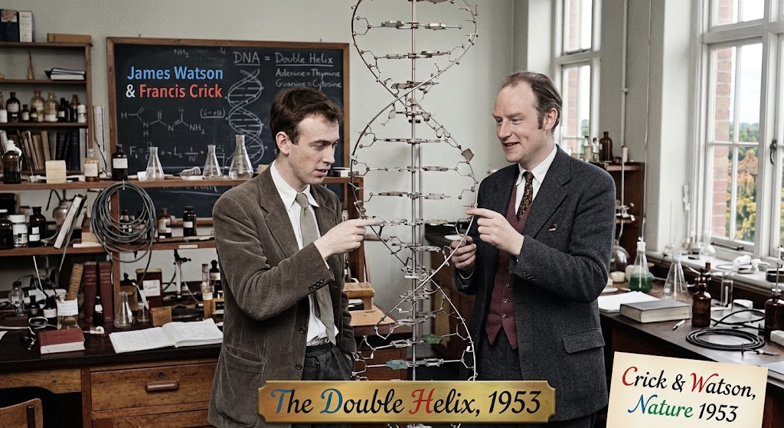

Slide 7
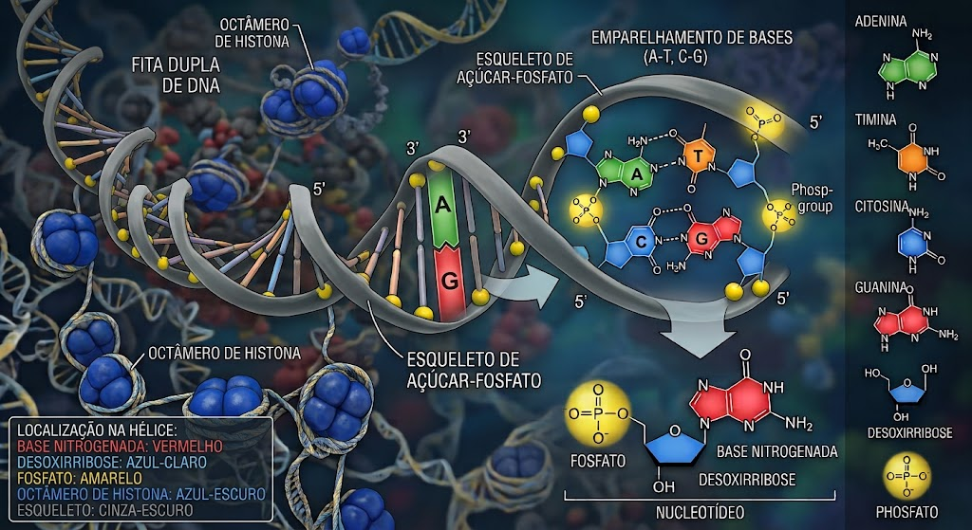

Slide 8
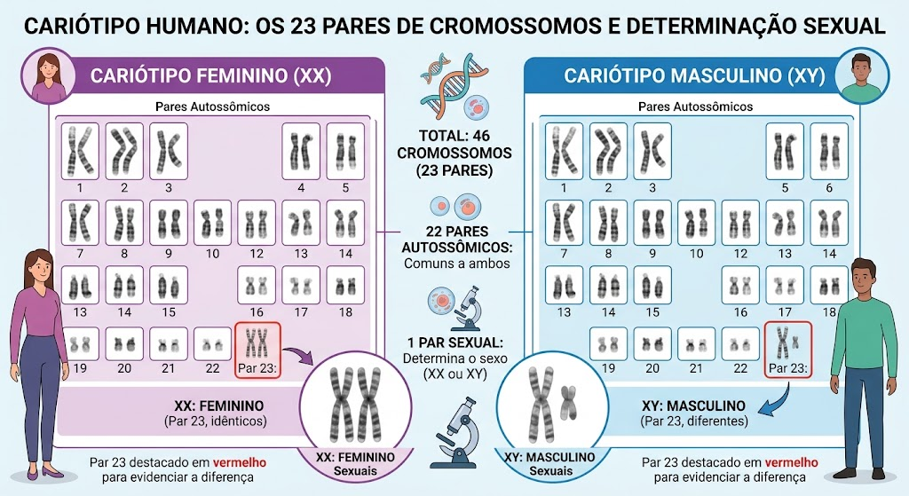

Slide 9
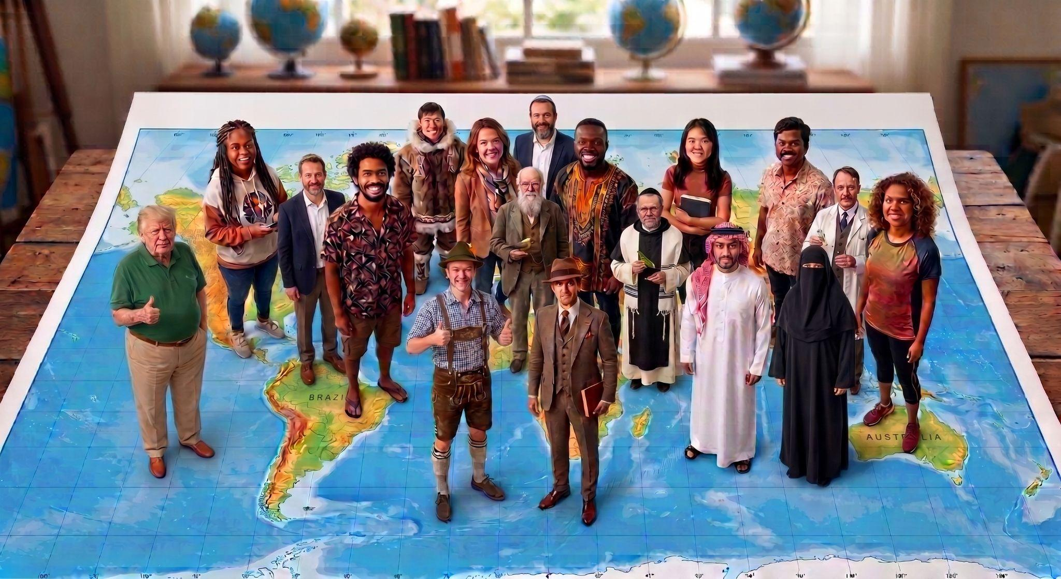

Slide 10
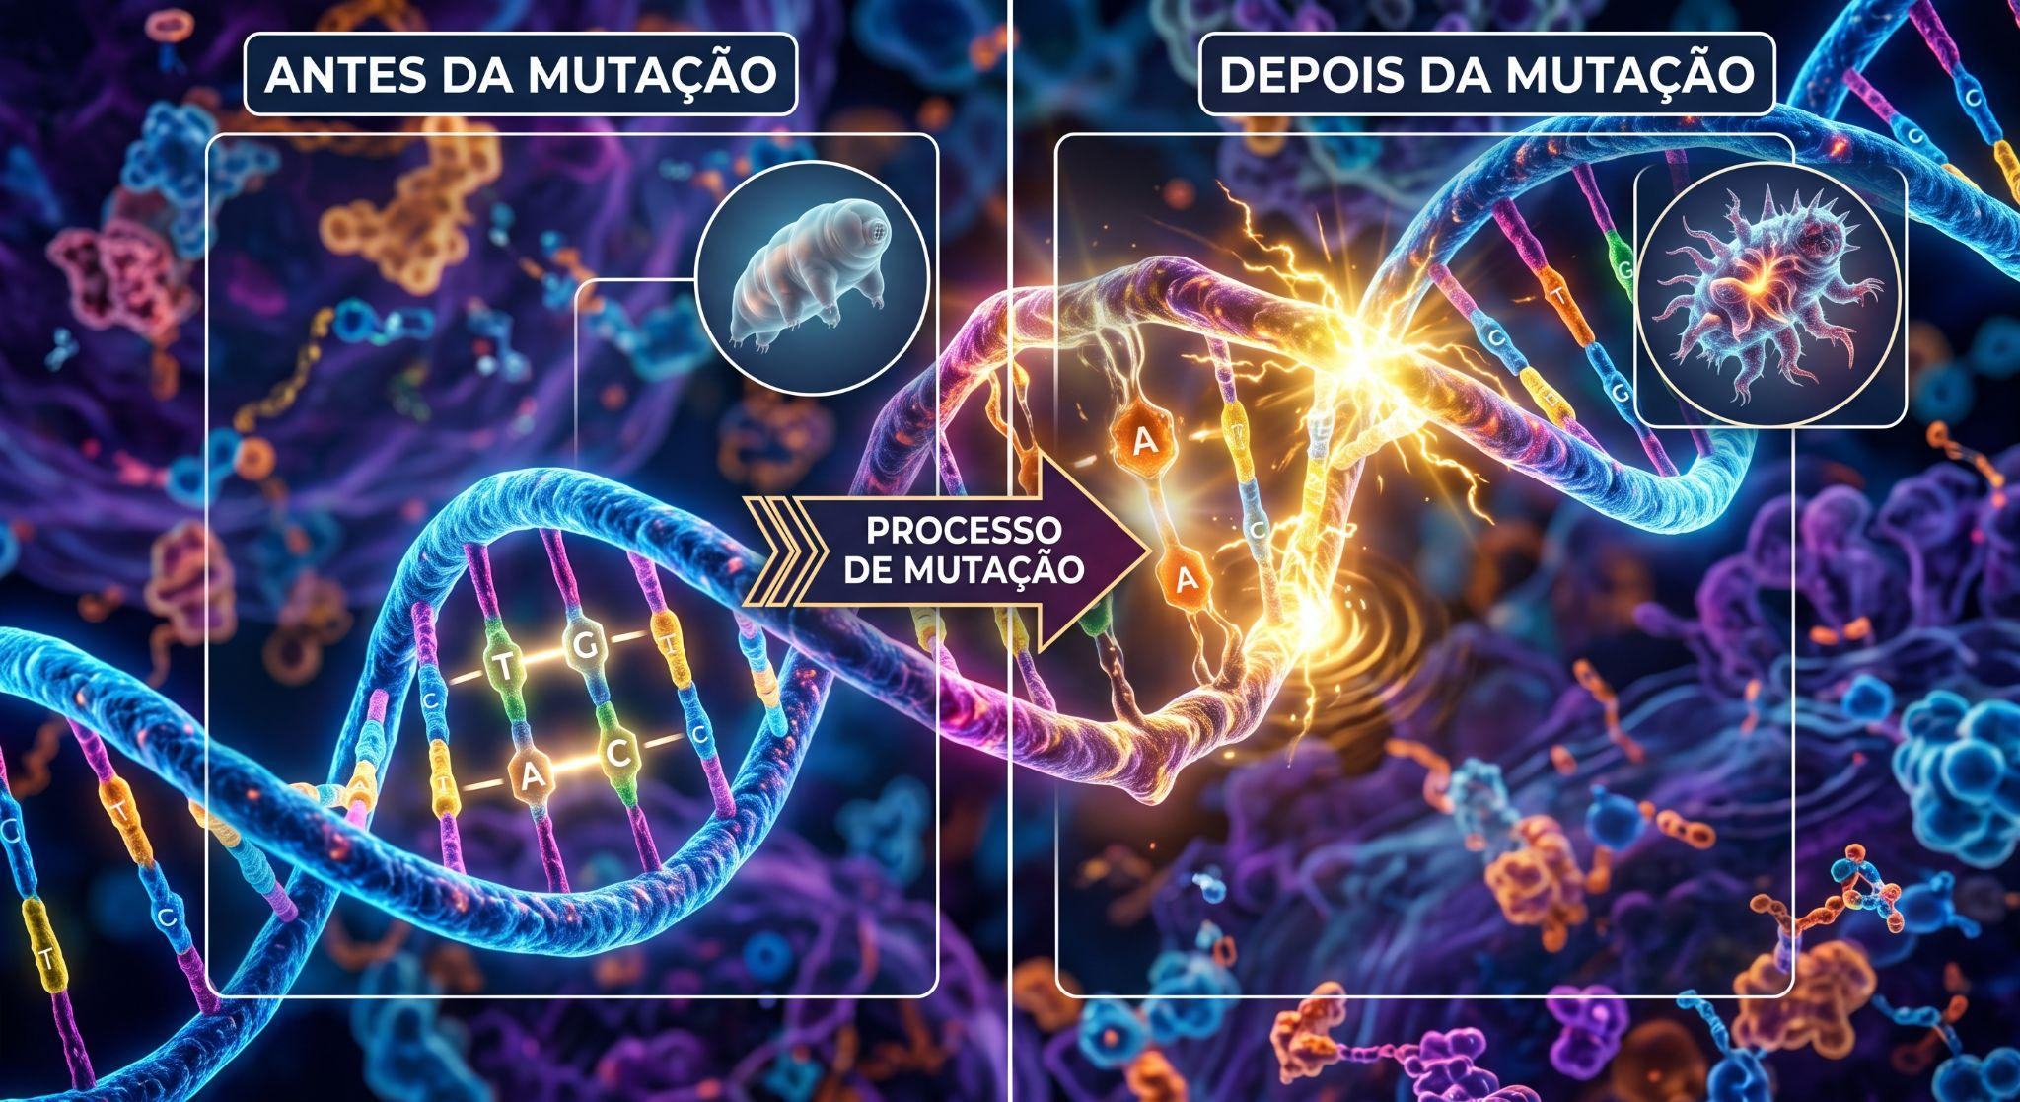

Slide 11
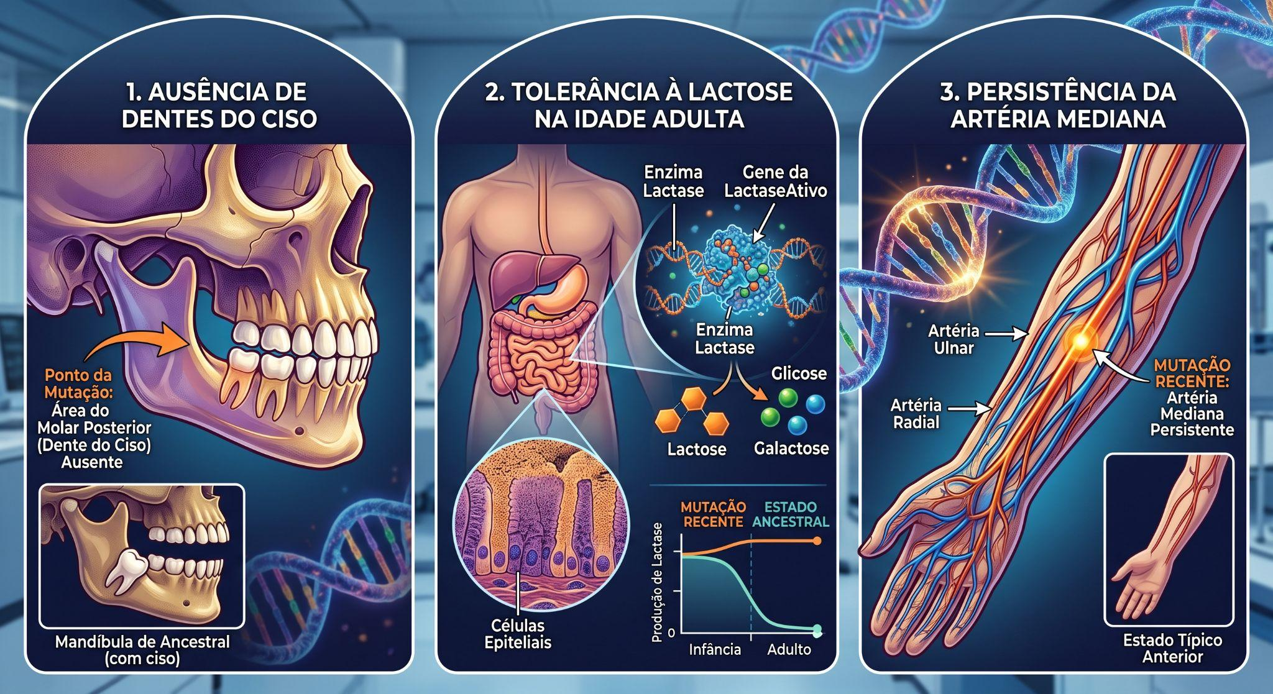

Slide 12
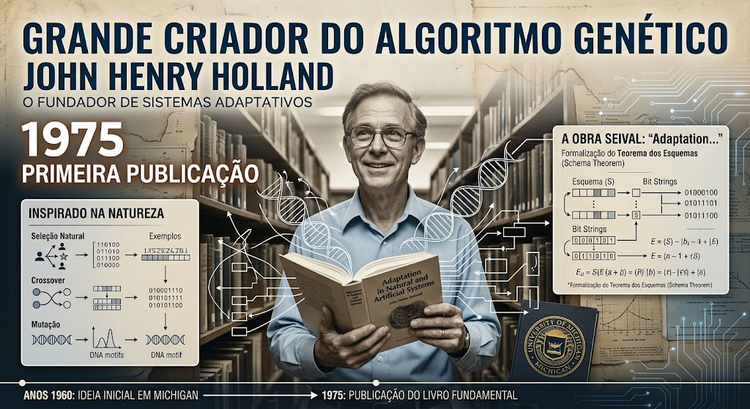

Slide 13
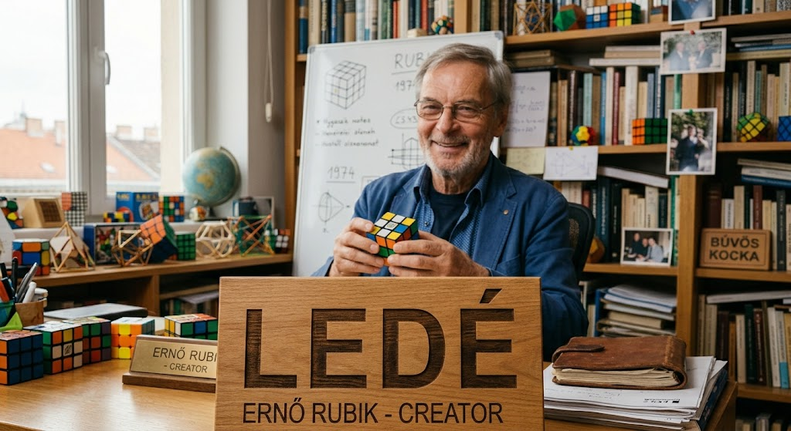
1975

Slide 14
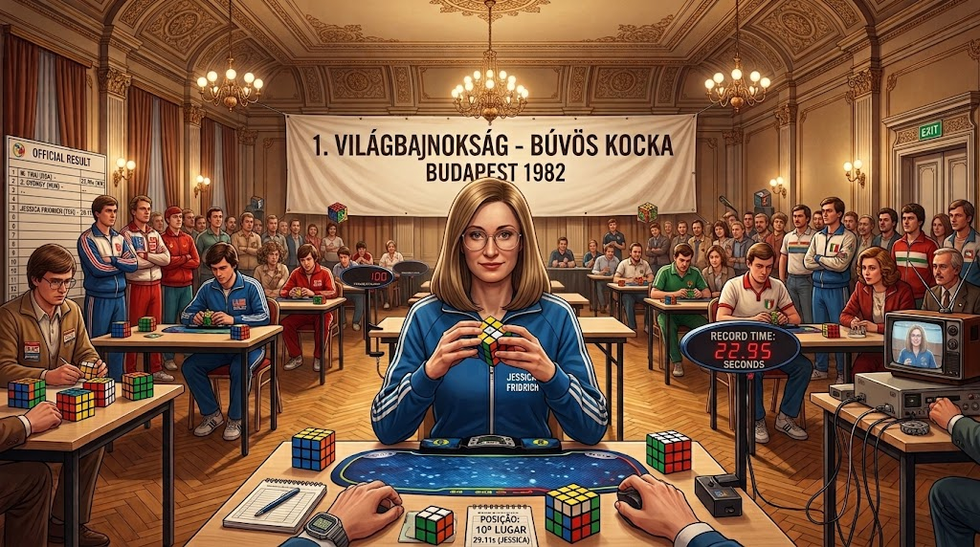

Slide 15
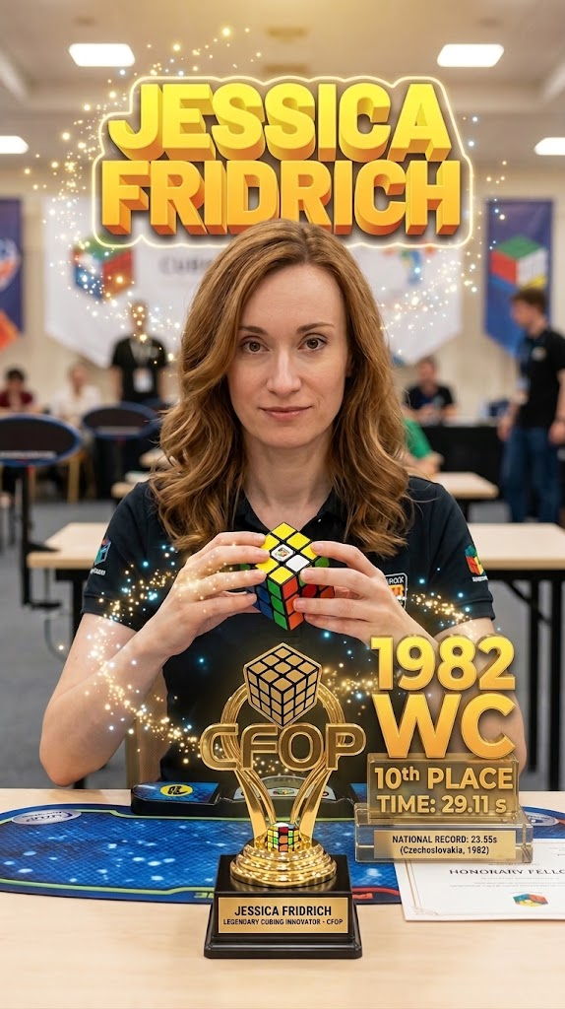
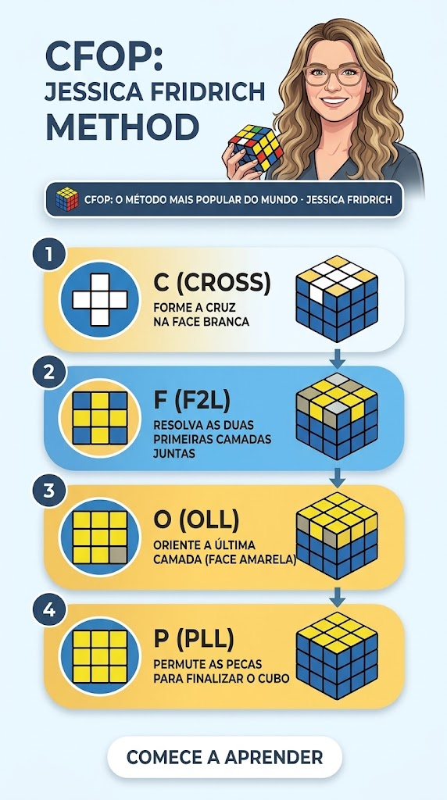
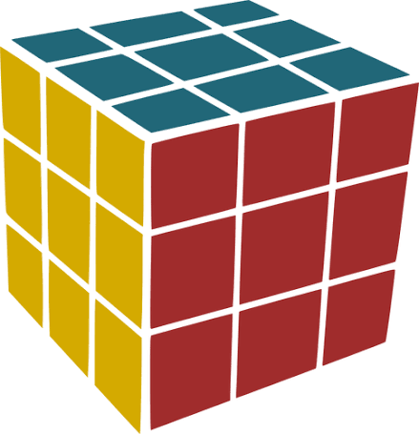

Slide 16
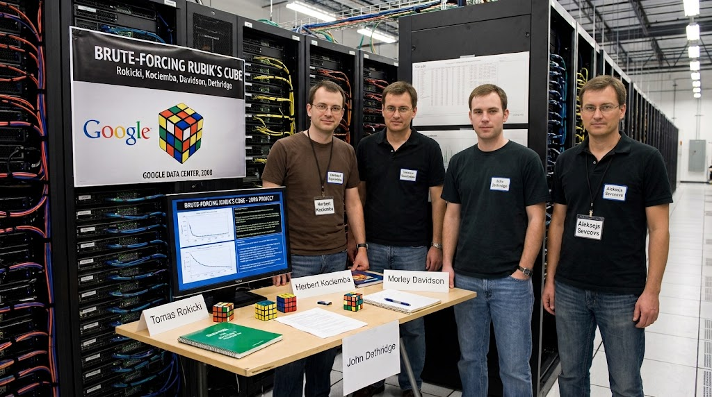
2008

Slide 17
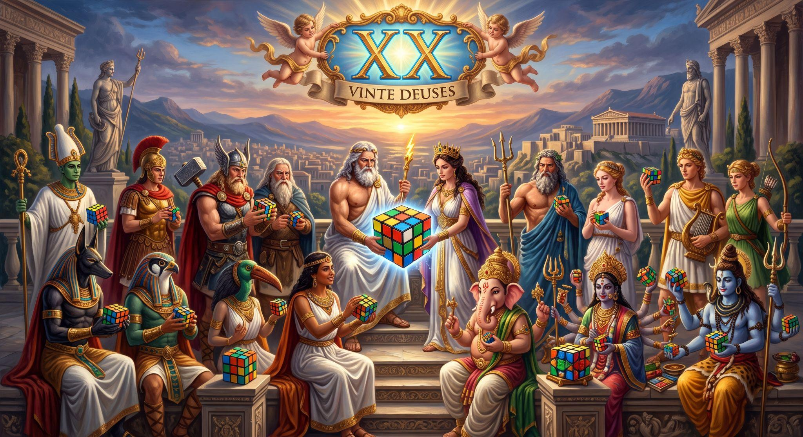

Slide 18
Referencias:
BALL, John. Spicilegium florae maroccanae. London: Longmans, Green, Reader, and Dyer, 1878. 470 p., 28 f. de estampas. Disponível em: https://archive.org/details/spicilegiumflora25ball. Acesso em: 5 set. 2026.
FRIDRICH, Jessica. My system for solving Rubik's cube. Jessica Fridrich's Rubik's Cube Page, Binghamton University, 2003. Disponível em: http://ws.binghamton.edu/fridrich/cube.html. Acesso em: 5 set. 2026.
HOLLAND, John H. Adaptation in Natural and Artificial Systems: an introductory analysis with applications to biology, control, and artificial intelligence. Cambridge, MA: The MIT Press, 1992. 211 p. (A Bradford Book). Disponível em: https://repo.darmajaya.ac.id/3794/1/Adaptation%20in%20Natural%20and%20Artificial%20Systems_%20An%20Introductory%20Analysis%20with%20Applications%20to%20Biology%2C%20Control%2C%20and%20Artificial%20Intelligence%20%28A%20Bradford%20Book%29%20%28%20PDFDrive%20%29.pdf. Acesso em: 5 set. 2026.
MENDEL, Gregor. Versuche über Pflanzen-Hybriden. Verhandlungen des naturforschenden Vereines in Brünn, Brünn, v. 4, p. 3-47, 1866. Disponível em: https://archive.org/details/verhandlungendes04natu. Acesso em: 5 set. 2026.
MIESCHER, Friedrich. Ueber die chemische Zusammensetzung der Eiterzellen. Medicinisch-chemische Untersuchungen, Berlin, v. 4, p. 441–460, 1871. Disponível em: https://archive.org/details/IA41547001_0103. Acesso em: 5 set. 2026.
MORGAN, Lewis Henry. Ancient Society: or researches in the lines of human progress from savagery through barbarism to civilization. New York: Henry Holt and Company, 1877. Disponível em: https://archive.org/details/Morgan1877AncientSociety. Acesso em: 5 set. 2026.
PEKONEN, Osmo. Cubed: The Puzzle of Us All by Ernő Rubik. The Mathematical Intelligencer, [s. l.], v. 43, n. 2, p. 77–78, 2021. Disponível em: https://doi.org/10.1007/s00283-021-10052-1. Acesso em: 5 set. 2026.
ROKICKI, Tomas; KOCIEMBA, Herbert; DAVIDSON, Morley; DETHRIDGE, John. Brute-forcing Rubik's cube: God's number is 20. 2010. Disponível em: https://kociemba.org/math/papers/rubik20.pdf. Acesso em: 5 set. 2026.
WATSON, James D.; CRICK, Francis H. C. Molecular structure of nucleic acids: a structure for deoxyribose nucleic acid. Nature, London, v. 171, n. 4356, p. 737–738, 25 abr. 1953. Disponível em: https://collections.nlm.nih.gov/ext/document/101584582X381/PDF/101584582X381.pdf. Acesso em: 5 set. 2026.

